Slide 1

PowerShell – An Auditors Best Friend
ISACA 2021 IT Security & Risk Symposium
November, 2021

Slide 2
Agenda
Speaker Introductions
Life of an Auditor
PowerShell the Tool
PowerShell the Gamechanger
Learning Resources
Questions

Slide 3

Speaker Introduction
Sunny Jamwal aka Sonny
Senior Manager Cybersecurity - MNP
Dalhousie University Alumni
Moved back to Halifax right before Covid
Obsessed with Russia’s cyber offense capabilities and Football (NFL)

Slide 4

Life of an Auditor
Airports/Hotels/Bus/Train/Car
Free Continental Breakfast
Never enough time
Scope creep
Gather relevant information
Sampling systems
Trust but Verify

Slide 5
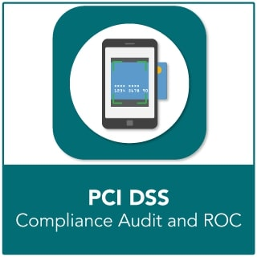
Life of an Auditor – Personal Story
Important Client
Huge deployment
>1000 Windows Servers
Spanned across two continents
10 Domain Controllers
Firewalls
Load Balancers
Networking Devices etc. etc.

Slide 6
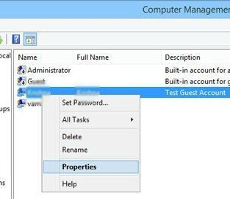
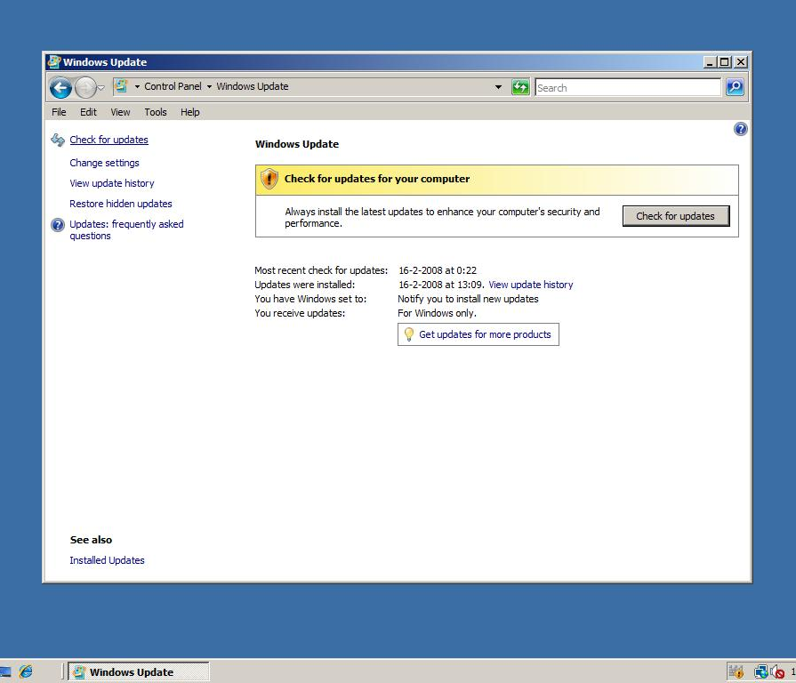
Life of an Auditor – Personal Story

Slide 7
Life of an Auditor
Inefficient
Time consuming
Labor intensive
Sampling problems
Cause heavy drinking

Slide 8
Windows PowerShell
Windows PowerShell is a Windows command-line shell.
Windows PowerShell is built on top of the .NET Framework
Windows PowerShell introduces the concept of a cmdlet single-function command-line tool built into the shell
Windows PowerShell accepts and returns .NET Framework objects.
PowerShell makes it easier to interact with WIN 32 API.
You don’t need to be a programmer to harness the power of .NET Framework.

Slide 9
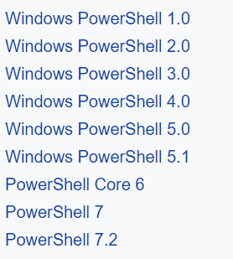

PowerShell

Slide 10
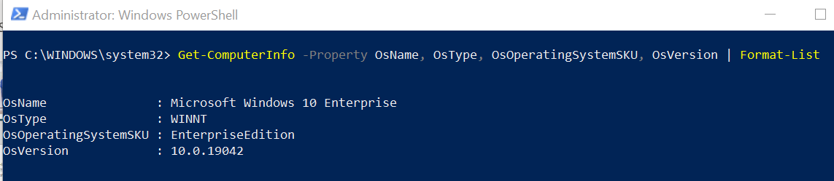
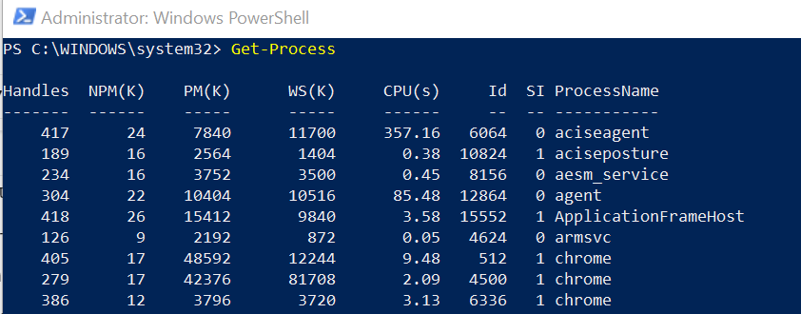
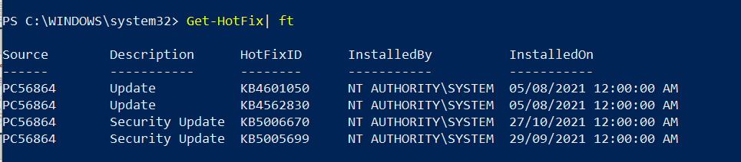
PowerShell the Tool

Slide 11
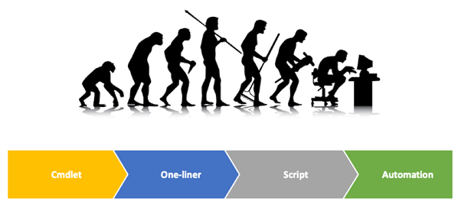
PowerShell the Tool

Slide 12
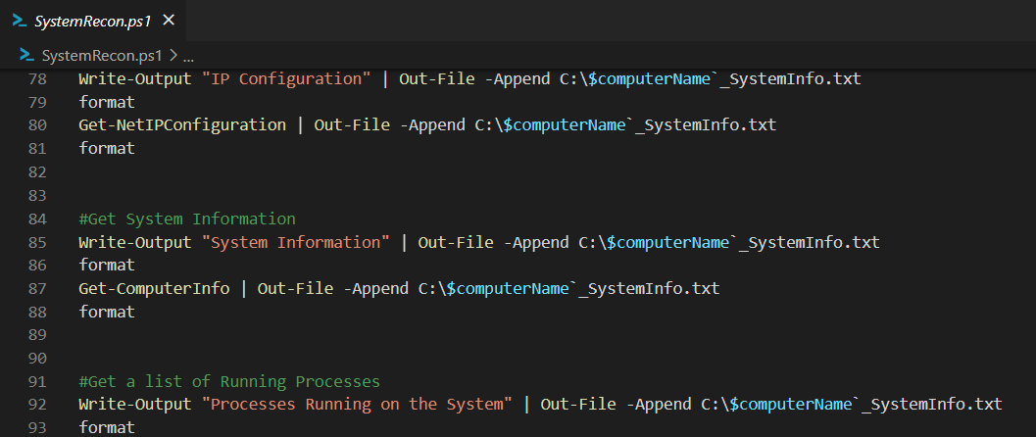
PowerShell the Tool

Slide 13
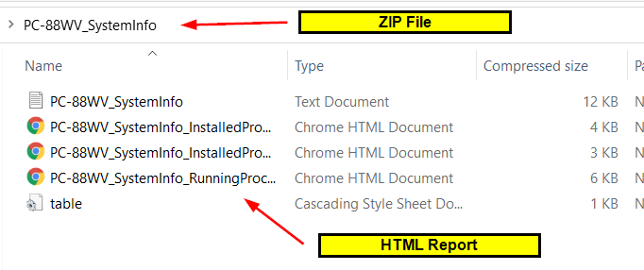
PowerShell the Tool

Slide 14
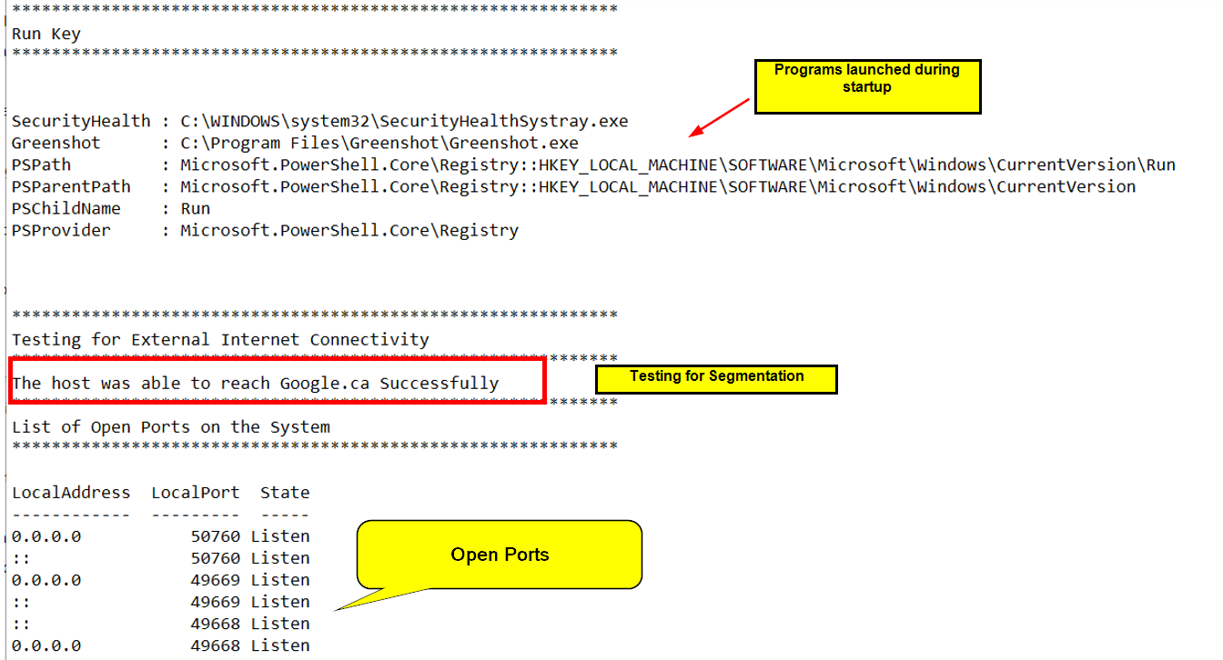
PowerShell the Tool

Slide 15
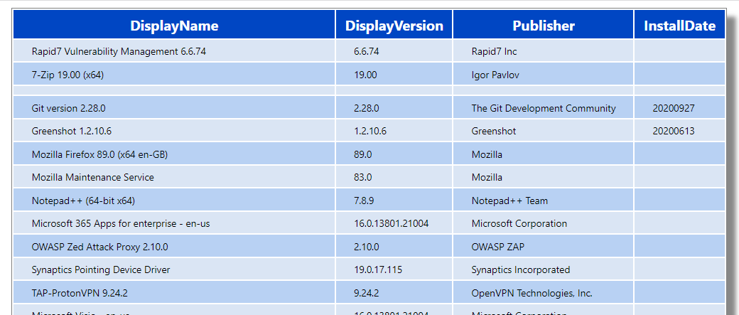
PowerShell the Tool

Slide 16
PowerShell the Tool

Slide 17
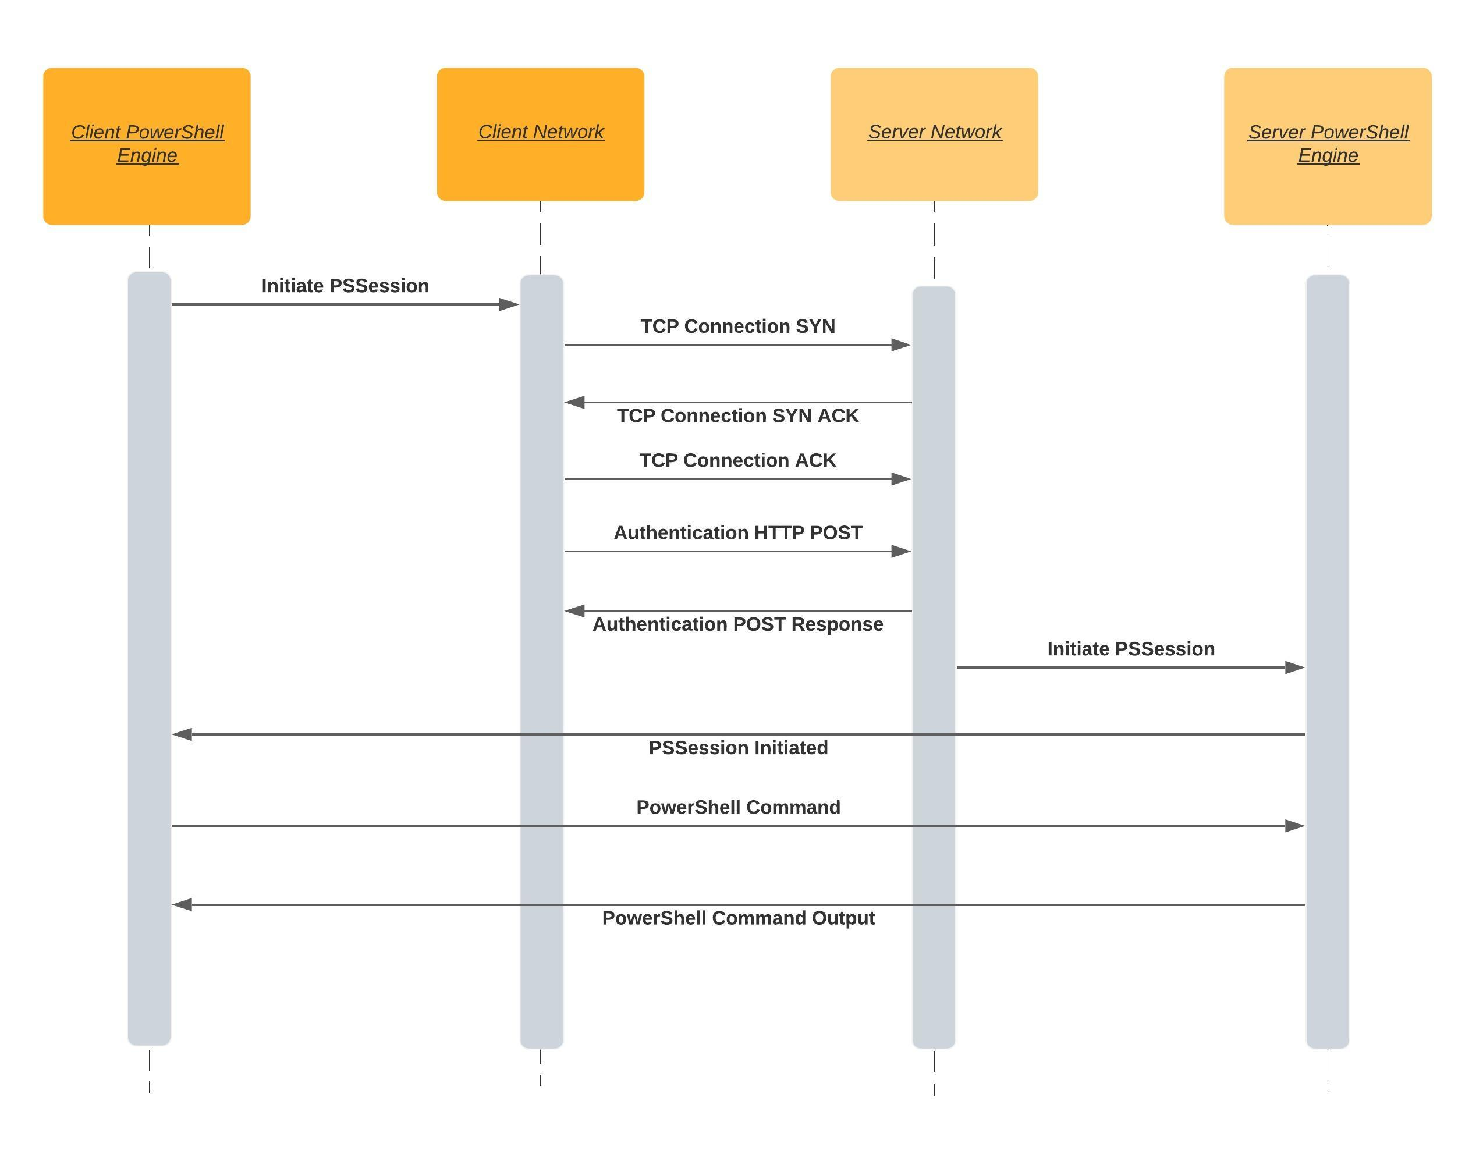
PowerShell the Gamechanger

Slide 18
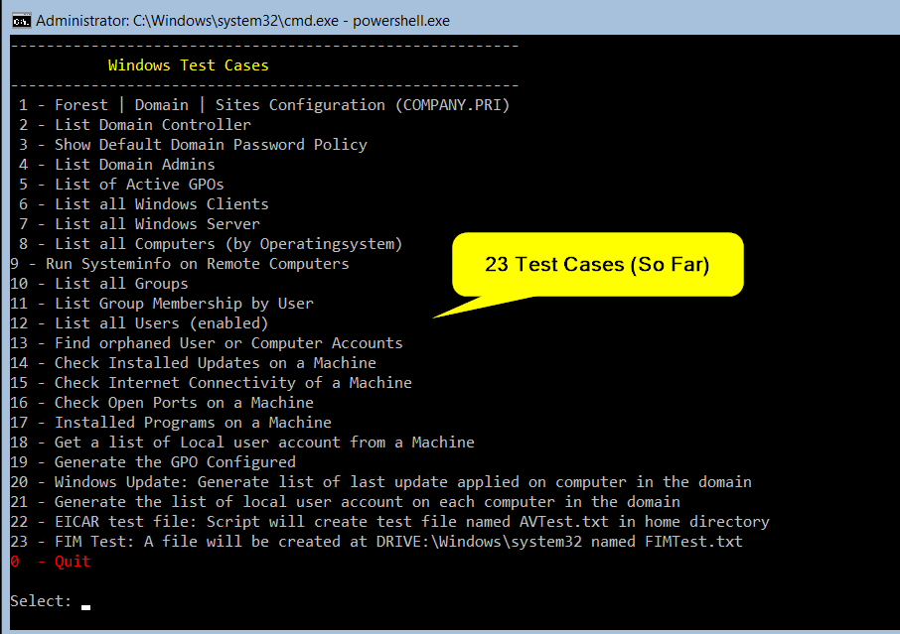
PowerShell the Gamechanger

Slide 19
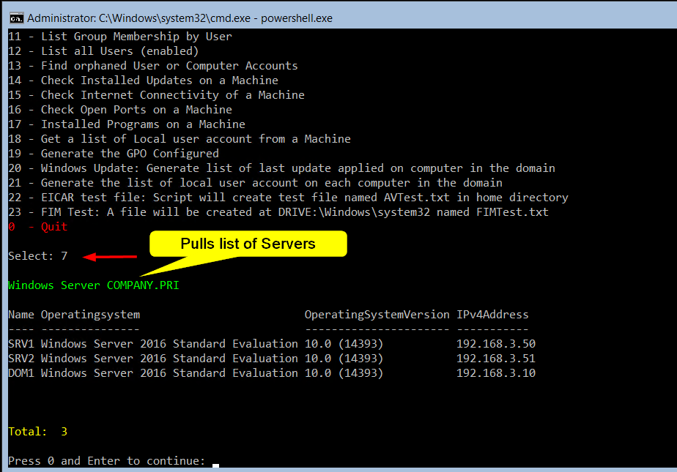
PowerShell the Gamechanger

Slide 20
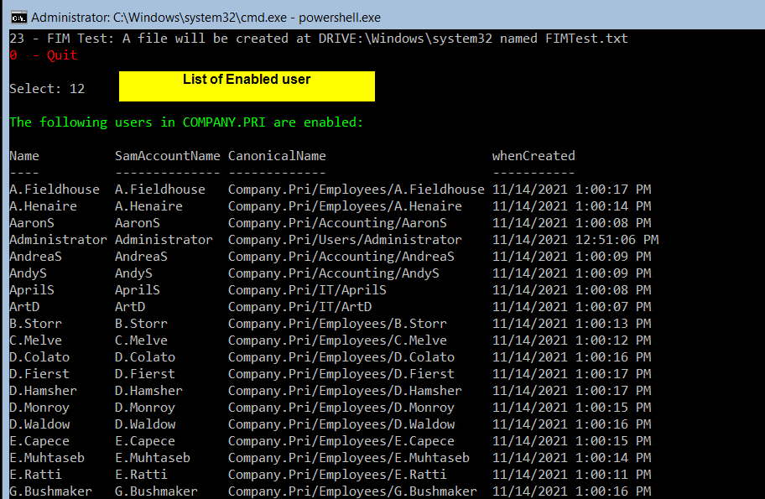
PowerShell the Gamechanger

Slide 21
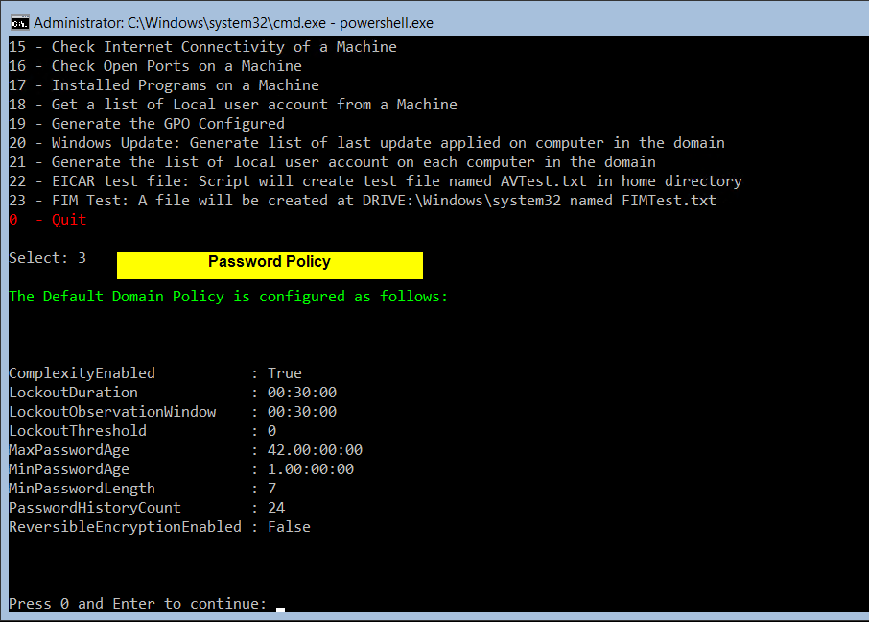
PowerShell the Gamechanger

Slide 22
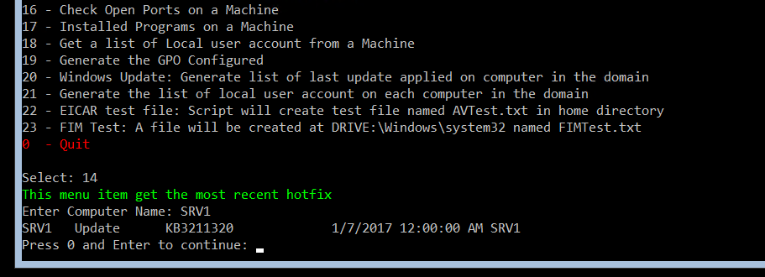
PowerShell the Gamechanger

Slide 23
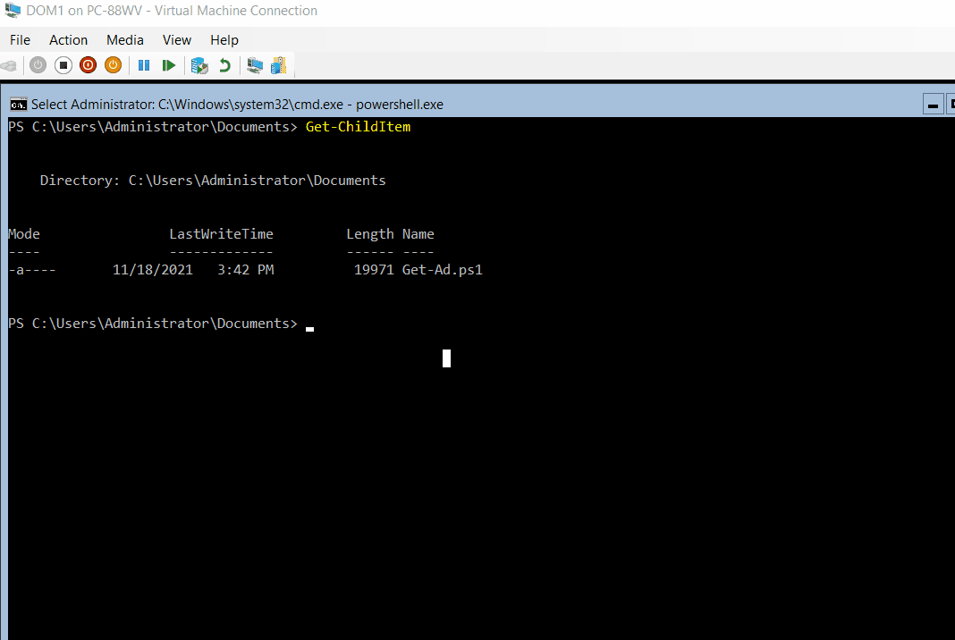

Slide 24
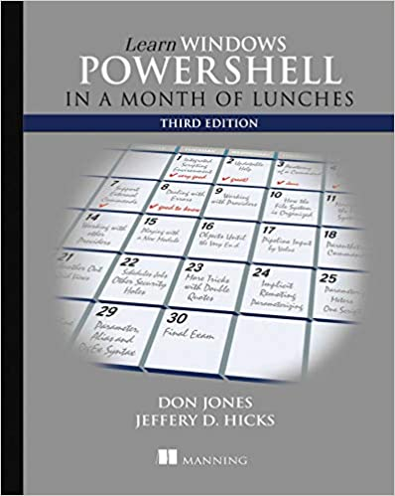



Resources

Slide 25
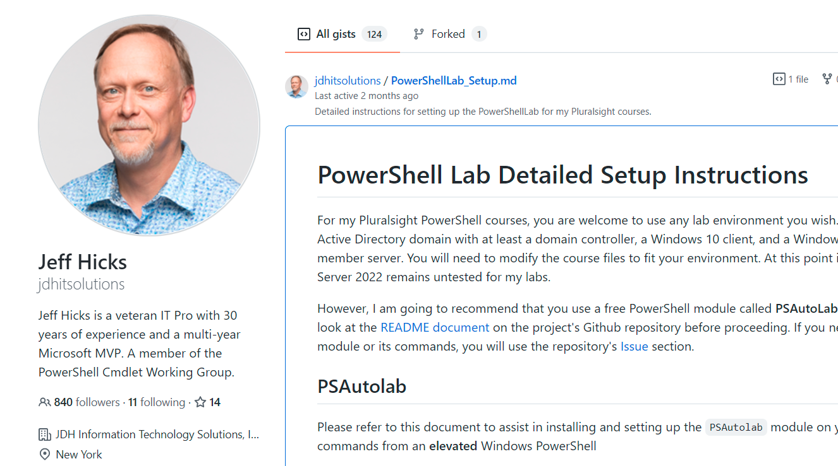
Resources

Slide 26

Thanks!!!
Q&A
@browinfosecguy

